Slide 1
Distributed Computer Systems
CT024-3-3-DCOMS and VE
Serialization

Slide 2
Teaching Contents
Serialization
Real World Example
Implementation of Serialization
Classes and Methods used for Serialization Program
Demo of Serialization program using Netbeans
Tutorial Exercise related to Serialization

Slide 3
TOPIC LEARNING OUTCOMES
At the end of this topic, you should be able to:
•Understand Serialization

Slide 4
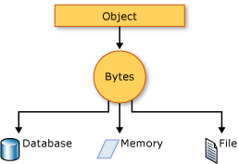
Serialization is the process of converting an object into a stream of bytes to store the object or transmit it to memory, a database, or a file.

Slide 5
Serialization - Real World Example -
David created an app for smartphones, and it asked you what your username is (which is a java object), you put in your name.
The next time the system runs, it will remember what your name is.
This is because by letting your application save objects to disk so it can read them back the next time it starts.

Slide 6
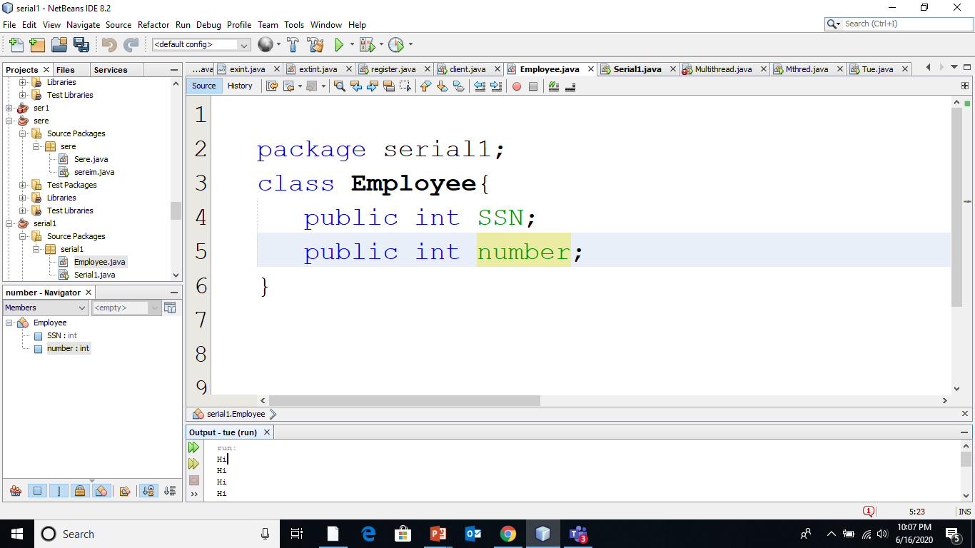
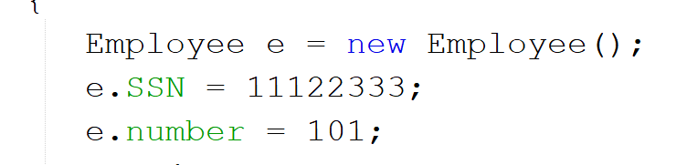
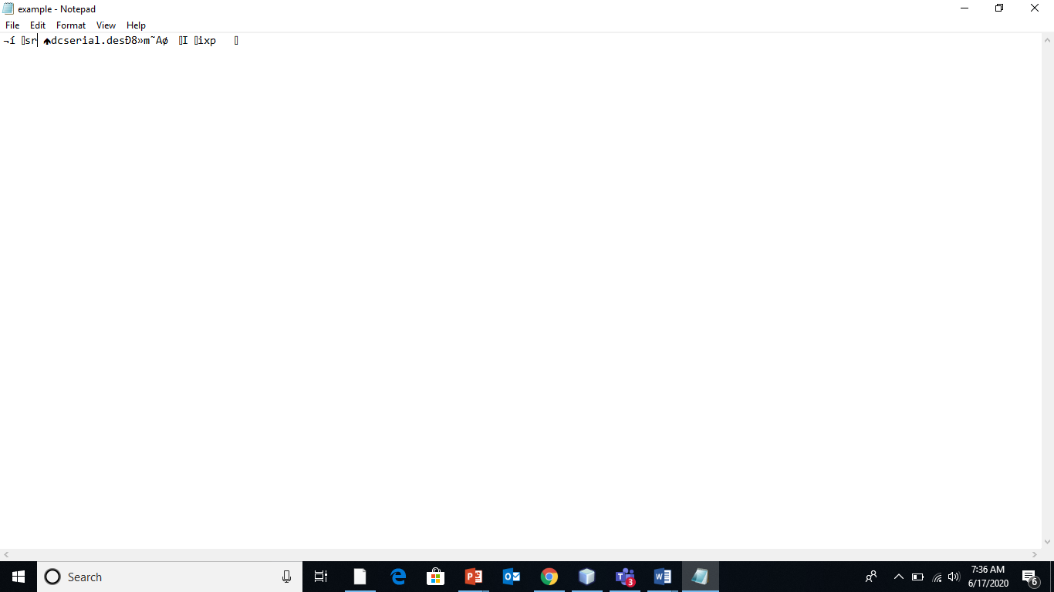

Slide 7
Classes & Methods used in Serialization
Class FileOutputStream
Class ObjectOutputStream are high-level streams that contain the methods for serializing an object.
The ObjectOutputStream class contains many write methods for writing various data types, but one method in particular stands out −
writeObject()
The above method serializes an Object and sends it to the output stream.
close()

Slide 8
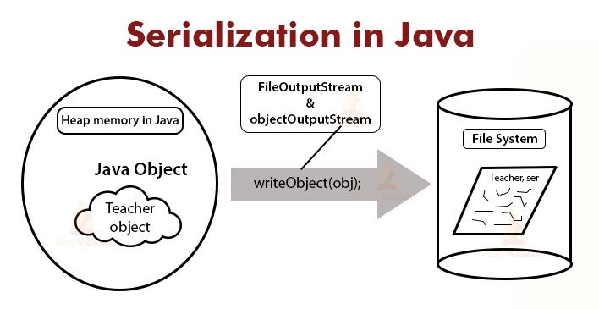
package serial1;
import java.io.*;
public class Serial1{
public static void main(String [] args) {
Employee e = new Employee();
e.SSN = 11122333;
e.number = 101;
try {
FileOutputStream fileOut =
new FileOutputStream("example.ser");
ObjectOutputStream out = new ObjectOutputStream(fileOut);
out.writeObject(e);
out.close();
fileOut.close();
System.out.println("Serialized data is saved in /tmp/example.ser");
} catch (IOException i) {
i.printStackTrace();
}
}
}
package serial1;
class Employee implements java.io.Serializable
{
public int SSN;
public int number;
}

Slide 9
Serialization Demo using Netbeans

Slide 10
Review Questions
What is Serialization?

Slide 11
Summary / Recap of Main Points
Introduction to Serialization
Working Principle
Implementation

Slide 12
What To Expect Next Week
In Class
Socket Programming

